Slide 1
Review 2
-2010030151 K S Satyavarsan
2010030071 Jyothin Movva
2010030040 Devaraj Acharya
2010030341 Snehith Kamepally
2010030329 Karthik

Slide 2
Abstract
The field of human resources analysis, which can be understood as an approach to human recourses management focused on data and analytical thinking.
Human resources analysis an optimal use of human resources to ensure that the human resources of an organization remain an asset and not a liability.
The project analyzes the data of the employees working in the organization.

Slide 3
Implementation flowchrat

Slide 4
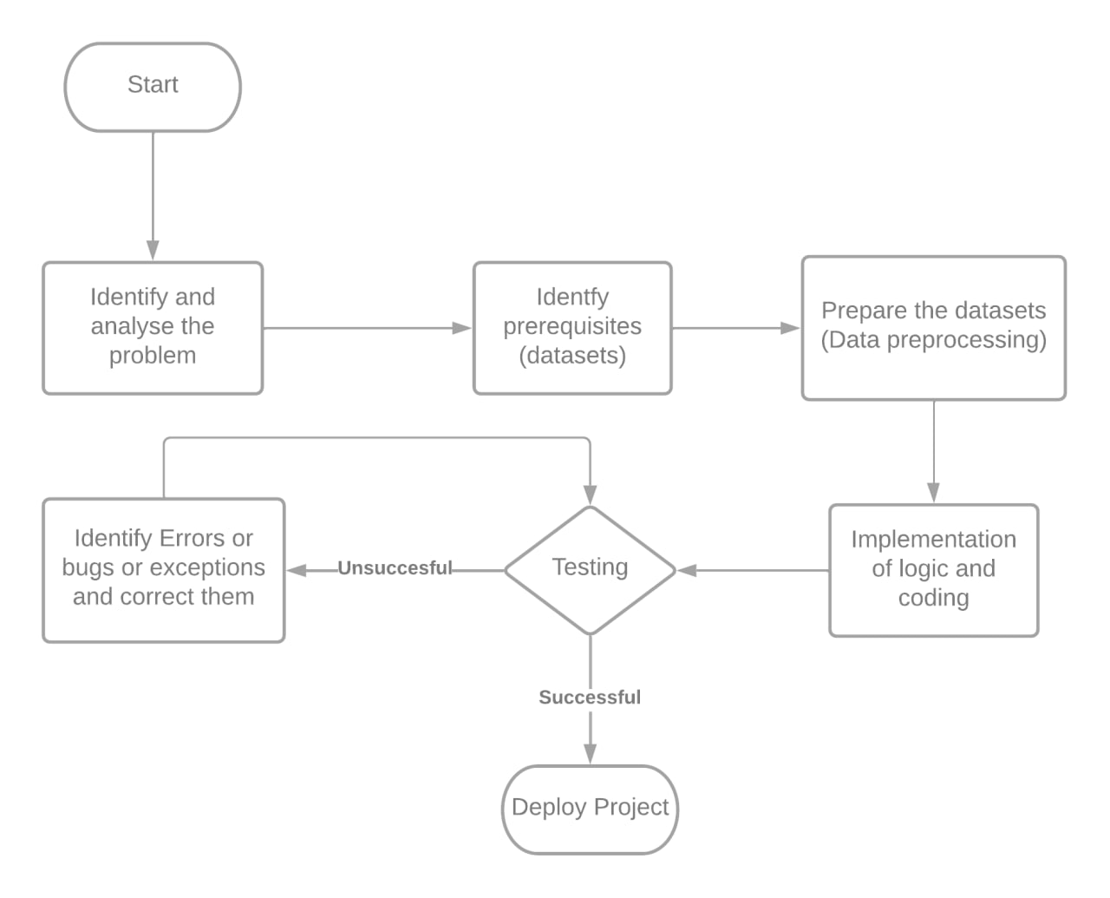

Slide 5
methods
The project is coded in python
The dependencies that are used are
Numpy – mathematical functions
Pandas – data analysis and manipulation
Matplotlib – plotting library
Seaborn – visualization library based on matplotlib
Ploty – plot 2d data and color scaling functionality

Slide 6
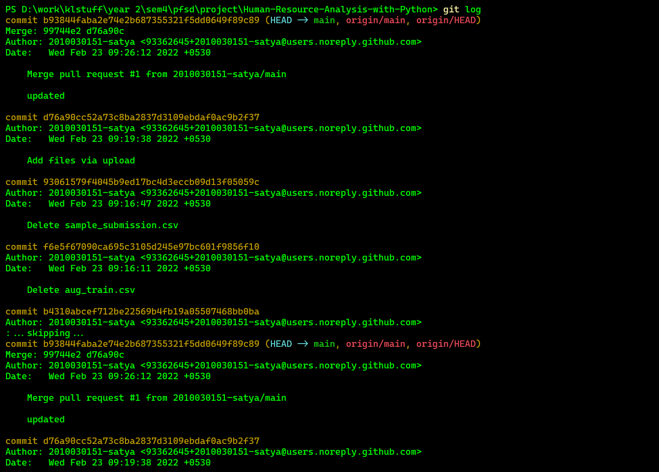
GITHUB COMMITS

Slide 7
Work progress
Data collected
Project will be implemented using seaborn, matplot.lib, ploty and flask
Flask environment for the project is functional
Generating plots from the given data is functional

Slide 8
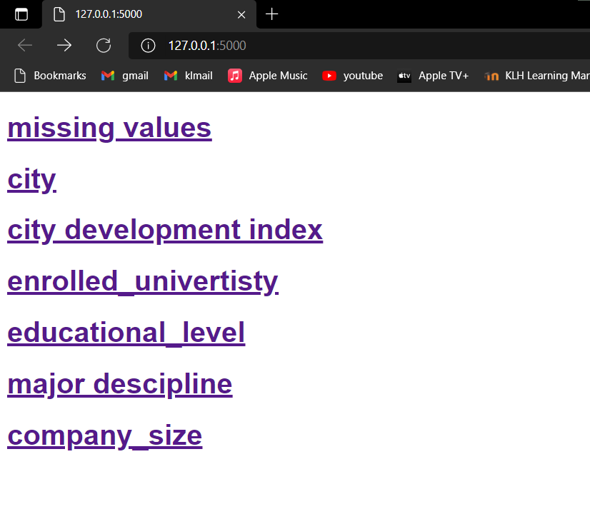
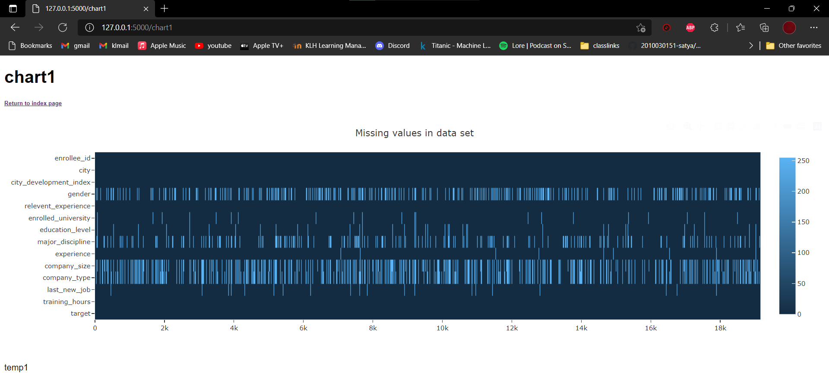
APLHA TESTING

Slide 9
Suggestions

Slide 10
Thank you

